Slide 1
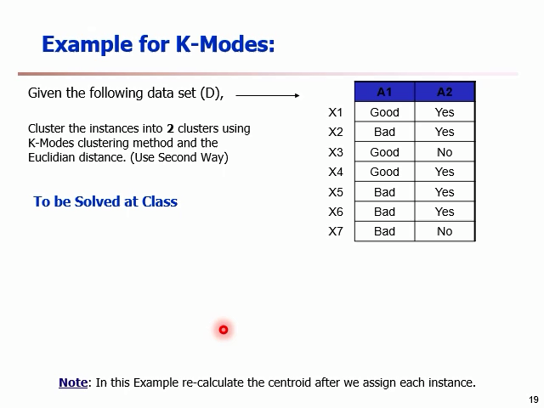
Partitioning:
c1
c2
x1,x2,x3,x4
x5,x6,x7
M1= good,yes
M2= bad,yes
Iteration 1:
X1:
good,yes
good,yes
good,yes
= 0
bad,yes
= 1
Matching x1 with m1
Matching x1 with m2
X1 belongs to C1 (because 0 is less than 1)
No change
X2:
bad,yes
bad,yes
good,yes
= 1
bad,yes
= 0
X2 belongs to C2
C2={x2,x5,x6,x7} recalculation of m2= bad,yes

Slide 2
X3:
good,no
good,no
good,yes
= 1
bad,yes
= 2
X3 belongs to C1
No change
X4:
good,yes
good,yes
good,yes
= 0
bad,yes
= 1
X4 belongs to C1
No change
X5:
bad,yes
bad,yes
good,yes
= 1
bad,yes
= 0
X5 belongs to C2
No change
X6:
bad,yes
bad,yes
good,yes
= 1
bad,yes
= 0
X6 belongs to C2
No change

Slide 3
X7:
bad,no
bad,no
good,yes
= 2
bad,yes
= 1
X7 belongs to C2
No change
c1
c2
x2,x5,x6,x7
x1,x3,x4
m1= m2= (good,yes) (bad,yes)
Iteration 2:
X1:
good,yes
good,yes
good,yes
= 0
bad,yes
= 1
X1 belongs to C1
No change
X2:
bad,yes
bad,yes
good,yes
= 1
bad,yes
= 0
X2 belongs to C2
No change

Slide 4
X3:
good,no
good,no
good,yes
= 1
bad,yes
= 2
X3 belongs to C1
No change
X4:
good,yes
good,yes
good,yes
= 0
bad,yes
= 1
X4 belongs to C1
No change
X5:
bad,yes
bad,yes
good,yes
= 1
bad,yes
= 0
X5 belongs to C2
No change
X6:
bad,yes
bad,yes
good,yes
= 1
bad,yes
= 0
X6 belongs to C2
No change
* Same as iteration 1 so we stop…

Slide 5
X7:
bad,no
bad,no
good,yes
= 2
bad,yes
= 1
X7 belongs to C2
No change
c1
c2
x2,x5,x6,x7
x1,x3,x4
m1= m2= (good,yes) (bad,yes)
* Same as iteration 1 so we stop…

